Slide 1
REQUEST AND RESPONSE OBJECTS (HTTP PROTOCOL)
-V. VANSHIKA, 22H51A05C4, CSE-D

Slide 2
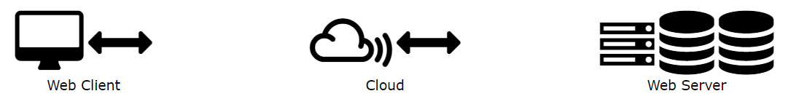
World Wide Web Communication
Communication between clients and servers is done by requests and responses:
A client (a browser) sends an HTTP request to the web
A web server receives the request
The server runs an application to process the request
The server returns an HTTP response (output) to the browser
The client (the browser) receives the response

Slide 3
HTTP REQUEST
An HTTP protocol is based on a client/server architecture where a web browser, robot, search engine, and so on act as HTTP clients, and the web server acts as a server. The session is a sequence of request-response network operations.
The client
An HTTP client sends a request to the server over a TCP/IP connection using one of the request methods, URI and protocol version, followed by a MIME-like message containing the request modifiers, client information, and any body content.
Typical HTTP clients are web browsers, file downloaders, web crawlers, etc.
The server
The HTTP server receiving the request responds with a status string including message protocol version and success/error code, followed by a MIME-like message containing server information, object meta-information, and possible object body content.

Slide 4
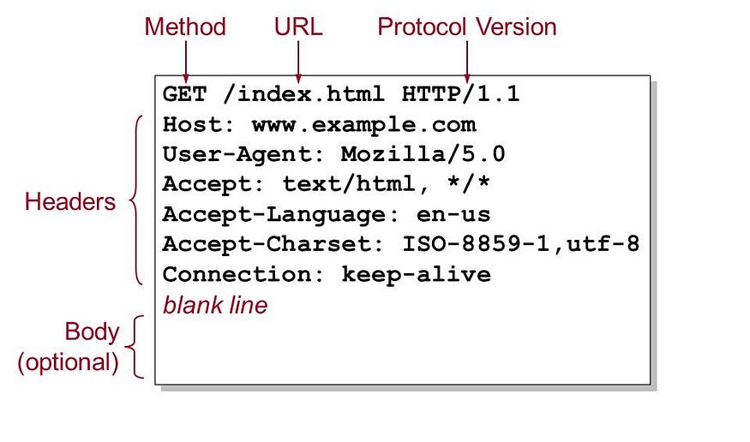
Structure Of HTTP Requests
The start line: It is used to describe the request or the status of the request. Indicates the protocol version and other information. Contains the requested resource or a response code (eg error). It is exactly one line in length.
HTTP header: Looks like a few lines of text specifying the request or describing the content of the message body. [_name:value_]
An empty string: This is necessary as an indication that the metadata for a particular request has been successfully sent.
The request body: This contains information about the request or the document sent in response to the request.

Slide 5
HTTP METHODS sequence of characters, excluding controls and delimiters, indicating the resource’s basic operation. A method is usually a short, capitalized English word. The method name is case-sensitive.
01
GET
03
PUT
02
POST
04
HEAD
a request for data from a server.
similar to POST except that there is no need for a server response in the case of background process execution.
used to send data to the server.
identical to the GET method, except that the server response has no body. A HEAD request is usually used to get metadata, check if the resource exists (URL validation) and see if it has changed since the last request.
The request target is actually a pointer to the URL the user needs. It consists of the protocol, the URL or IP address, and the path to the resource stored on the server.

Slide 6
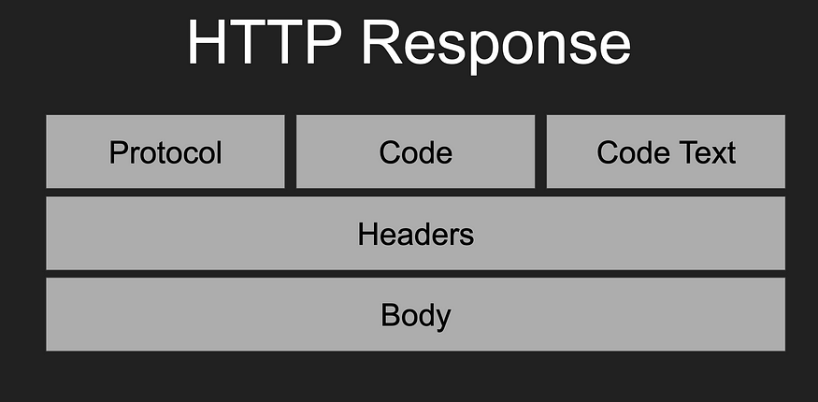
HTTP RESPONSE
An HTTP response is what a server sends back to the client after receiving and processing an HTTP request. It is a key part of the data exchange in web communications, essentially being the server’s answer to the client’s request.

Slide 7
Components of HTTP response
Status Line -This is the first line of the response and includes:
HTTP Version: Indicates the HTTP protocol version used (e.g., HTTP/1.1).
Status Code: A three-digit number that indicates the outcome of the request. Common status codes include 200 (OK, request succeeded), 404 (Not Found, the resource can’t be found), 500 (Internal Server Error), etc.
Status Text: A brief, human-readable explanation of the status code (e.g., OK, Not Found, Internal Server Error).

Slide 8
Response Headers: These are key-value pairs providing additional information about the response. They can include details such as the server type, content type, content length, caching policies, set cookies, and other metadata.
Blank Line: A blank line signifies the end of the header section.
Response Body: This part of the response contains the actual data or resource that the client requested.
For example, it could be an HTML file, JSON data, an image, etc. In some cases, particularly when the response indicates an error (like a 404), the body might contain a message explaining the error.

Slide 9
Example
REQUEST
GET /about.html HTTP/1.1
Host: example.com
User-Agent: Mozilla/5.0
RESPONSE
HTTP/1.1 200 OK
Content-Type: text/html
Content-Length: 342
<html>
<body>
<h1>About Us</h1>
<p>Welcome to our website!</p>
</body>
</html>

Slide 10
Other server objects
Session
Cookie
Error handling
Routing
Many web servers use sessions to track users across multiple requests. The session object is: Session ID, data.
Cookies are a way to store data on the client that can be sent back to the server with each request. The server uses a cookie object to: Set, Read
Servers often include objects or mechanisms for handling errors: Status codes, error pages, logging
In many web frameworks, a routing object handles directing requests to the appropriate handler based on the URL and HTTP method: route matching, parameters extraction.

Slide 11
THANK YOU

